Slide 1
IMAGE SCENARIO DESCRIPTION FOR THE BLIND USING DSP
Under the guidance of
Mr. A.V.D.N Murthy, Assistant Professor Department of CSE
M. Simhachalam (19KD1A05A9)
K. Jagadeesh (19KD1A0594)
P. Law Bind Kumar (19KD1A05A3)
R. Kushal Kumar (20KD1A0512)

Slide 2
AGENDA
Introduction
Existing System and Limitations
Proposed system and Advantages
System Architecture
Algorithm
Implementation
Result
Conclusion

Slide 3
INTRODUCTION
Image description provides the process of describing the content from an image . The idea is based on the detection of objects and what actions in the input image . Bottom-up and top-down approaches are two main approaches of image description . Bottom-up approaches generate contents in an input image , and then combine them into a caption . Top-down approaches generate a semantic representation of an input image that is then decoded into a caption using various architectures like recurrent neural networks . Image description could have many benefits , for instance by helping visually impaired people better understand the content of images on the web . Now , we will explain what exactly will happen . Image caption generation is a task that involves image processing and natural language processing concepts to recognize the context of an image and describe them in a natural language like English or any other language. Our model is based on a deep learning neural network that consists of a vision CNN followed by a language generating RNN. It generates complete sentences as an output captions or descriptive sentences. Here we use Encoder - Decoder model to generate captions syntactically semantically correct further we convert these generated captions into speech with help of Digital Signal Processing(DSP).

Slide 4
Existing System and Limitations
Long Short-Term Memory (LSTM) networks are a type of Recurrent Neural Network (RNN) capable of learning order dependence in sequence prediction problems. This is most used in complex problems like Machine Translation, Speech Recognition, and many more.
The reason behind developing LSTM was, when we go deeper into a neural network if the gradients are very small or zero, then little to no training can take place, leading to poor predictive performance and this problem was encountered when training traditional RNNs. LSTM networks are well- suited for classifying, processing, and making predictions based on time series data since there can be lags of unknown duration between important events in a time series.
LSTM is way more effective and better compared to the traditional RNN as it overcomes the short term memory limitations of the RNN. LSTM can carry out relevant information throughout the processing of inputs and discards non-relevant information with a forget gate.

Slide 5
limitations
LSTM can fail in image caption generation when the image contains complex objects or scenes that require more context than a single sentence to describe.
Additionally, LSTM can struggle with multiple objects or people as it may not be able to accurately capture the relationship between them.
Finally, LSTM can also fail when the image contains subtle details that require more sophisticated language processing capabilities than what is available in LSTM model.

Slide 6
Proposed system and Advantages
Now, to overcome the drawbacks of LSTM in our project we have taken the advanced model called Encoder-Decoder model.
The encoder-decoder algorithm is a type of neural network architecture that is commonly used for tasks such as language translation, image captioning, and speech recognition. In this architecture, the input data is first passed through an encoder network, which transforms it into a fixed-length vector representation.
The encoder is typically composed of one or more layers of neural network units, such as convolutional or recurrent layers, that extract and compress the most relevant information from the input. The encoded representation is then passed to a decoder network, which generates the output based on the encoded input. The decoder is typically composed of one or more layers of neural network units, such as LSTM or GRU layers, that use the encoded representation to generate the output.
Encoder-Decoder models have become very popular for image caption generation tasks. In this approach, the model consists of two parts: an encoder and a decoder. The encoder extracts features from the input image and the decoder generates a sentence that describes the image based on the extracted features

Slide 7
Advantages
Capturing complex image features: The encoder component of the algorithm uses pre-trained convolutional neural networks (CNNs) to extract high-level features from the input image. These features capture complex details and patterns of the image, making it easier for the model to generate accurate and detailed captions.
Flexibility in generating captions: The decoder component of the algorithm uses a recurrent neural network (RNN) to generate captions one word at a time. This flexibility allows the model to generate captions of varying lengths and structures, which can capture the diverse ways in which humans describe images.
Transfer learning: The encoder component of the algorithm can be pre-trained on large image datasets, such as ImageNet, and then fine-tuned on a smaller dataset specific to the image captioning task. This transfer learning approach can help improve the model's performance and reduce training time.

Slide 8
End-to-end training: The encoder-decoder algorithm can be trained end-to-end using a single loss function, which optimizes both the encoder and decoder components of the model simultaneously. This approach can lead to better integration of the two components, resulting in more accurate and coherent captions.
Generalization: The encoder-decoder algorithm can generalize well to new images, meaning that it can generate accurate captions for images it has never seen before. This is because the model learns to capture the underlying structure of the image and generate captions based on that structure, rather than just memorizing specific image-caption pairs.

Slide 9
SYSTEM ARCHITECTURE
ENCODER
In image captioning, an encoder is a component of the overall architecture that is responsible for extracting features from an input image. The encoder takes in an image as input and produces a fixed-length vector of numerical features that represents the contents of the image. The encoder is typically a convolutional neural network (CNN) that has been pre-trained on a large dataset of images, such as ImageNet. The CNN processes the image through multiple layers of convolutions, pooling, and non-linear activations to produce a high-level representation of the image
DECODER
In image captioning, a decoder is a component of the system that generates a natural language description of an image. The decoder takes as input a vector representation of the image, which is typically obtained using a convolutional neural network (CNN), and produces a sequence of words that describe the image. The decoder is typically implemented as a recurrent neural network (RNN), such as a long short-term memory (LSTM) or gated recurrent unit (GRU), which is trained to generate a sequence of words that corresponds to the image

Slide 10
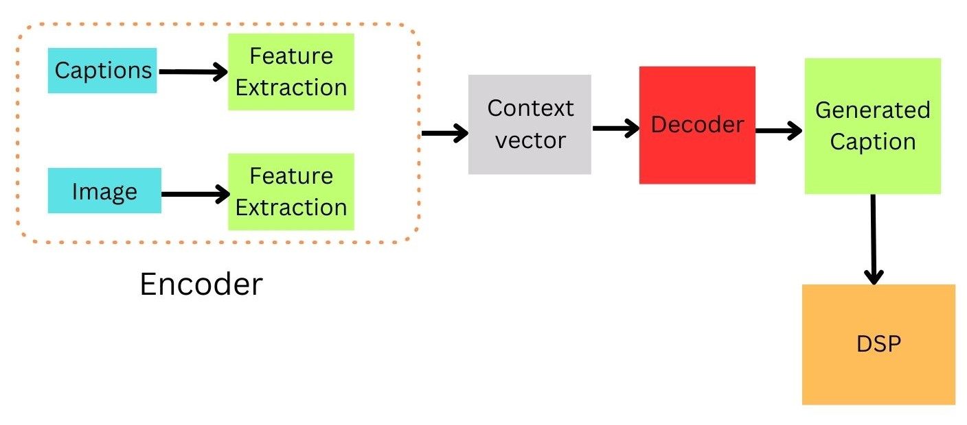
Fig 1:System Architecture

Slide 11
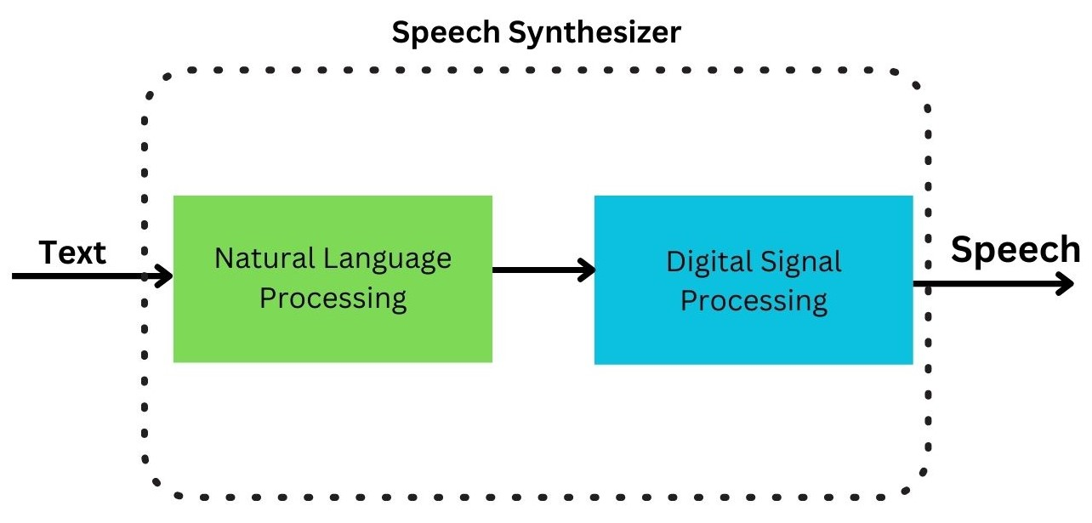
Digital Signal Processing
A Text-to-speech synthesizer is an application that converts text into spoken word, by analyzing and processing the text using Natural Language Processing (NLP) and then using Digital Signal Processing (DSP) technology to convert this processed text into synthesized speech representation of the text. Here, we developed a useful text-to-speech synthesizer in the form of a simple application that converts generated caption into synthesized speech and reads out to the user which can then be saved as an mp3. file. The development of a text to speech synthesizer will be of great help to people with visual impairment and make making through large volume of text easier.
Fig 2: Digital Signal Processing Architecture

Slide 12
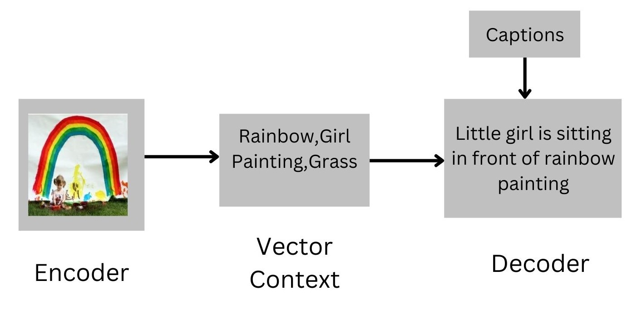
example

Slide 13
Algorithms
The encoder-decoder algorithm is a type of neural network architecture that is commonly used for tasks such as language translation, image captioning, and speech recognition. In this architecture, the input data is first passed through an encoder network, which transforms it into a fixed-length vector representation. The encoder is typically composed of one or more layers of neural network units, such as convolutional or recurrent layers, that extract and compress the most relevant information from the input. The encoded representation is then passed to a decoder network, which generates the output based on the encoded input. The decoder is typically composed of one or more layers of neural network units, such as LSTM or GRU layers, that use the encoded representation to generate the output. Encoder-Decoder models have become very popular for image caption generation tasks. In this approach, the model consists of two parts: an encoder and a decoder. The encoder extracts features from the input image and the decoder generates a sentence that describes the image based on the extracted features.

Slide 14
Implementation
SOURCE CODE
Import Modules
import os
import pickle
import numpy as np
from tqdm. notebook import tqdm
from tensorflow.keras.applications. vgg16 import VGG16, preprocess_input
from tensorflow. keras. preprocessing.image import load_img, img_to_array
from tensorflow.keras.preprocessing.text import Tokenizer
from tensorflow.keras.preprocessing.sequence import pad_sequences
from tensorflow.keras.models import Model

Slide 15
from tensorflow.keras.utils import to_categorical, plot_model
from tensorflow.keras.layers import Input, Dense, LSTM, Embedding, Dropout, add
BASE_DIR = '/kaggle/input/flickr8k’
Preprocess Text Data
def clean(mapping):
for key, captions in mapping.items():
for i in range(len(captions)):
# take one caption at a time
caption = captions[i]
# preprocessing steps
# convert to lowercase
caption = caption.lower()
# delete digits, special chars, etc.,

Slide 16
caption = caption.replace('[^A-Za-z]', '')
# delete additional spaces
caption = caption.replace('\s+', ' ')# add start and end tags to the caption
caption = 'startseq ' + " ".join([word for word in caption.split() if len(word)>1]) + ' endseq'
captions[i] = caption
Test with Real Image
vgg_model = VGG16()
vgg_model = Model(inputs=vgg_model.inputs, outputs=vgg_model.layers[-2].output)
image_path = '/kaggle/input/flickr8k/Images/1000268201_693b08cb0e.jpg'
image = load_img(image_path, target_size=(224, 224))
# convert image pixels to numpy array
image = img_to_array(image)
generate_caption("1001773457_577c3a7d70.jpg")

Slide 17

Result
startseq little girl covered in paint sits in front of painted rainbow with her hands in bowl endseq
startseq little girl is sitting in front of large painted rainbow endseq
startseq small girl in the grass plays with fingerpaints in front of white canvas with rainbow on it endseq
startseq there is girl with pigtails sitting in front of rainbow painting endseq
startseq young girl with pigtails painting outside in the grass endseq
--------------------Predicted--------------------
startseq little girl in pink dress is lying on the side of the grass endseq
Fig 1: After Uploading image in Encoder-Decoder model the predicted caption is
Little girl in pink dress is lying on the side of the grass

Slide 18
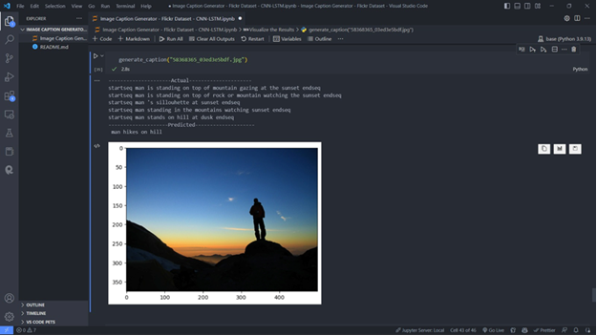
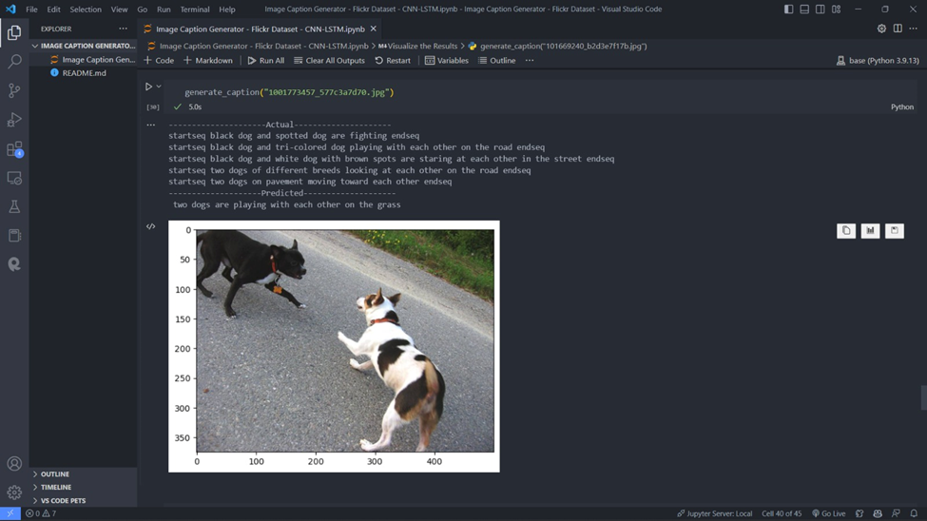
Fig 3: After Uploading image in Encoder-Decoder model the predicted caption is
Two dogs playing with each other
Fig 2: After Uploading image in Encoder-Decoder model the predicted caption is
Man hikes on hill

Slide 19
CONCLUSION
In conclusion, an image caption generator using encoder-decoder architecture is a powerful tool that can automatically generate captions for images. This approach involves encoding the image into a fixed-length vector representation using a convolutional neural network (CNN), and then decoding the vector into a natural language sentence using a recurrent neural network (RNN).
The encoder-decoder architecture has shown impressive results in generating captions that are accurate and relevant to the content of the image. This model can be trained on datasets such as Flickr8k, which contain a large number of images with corresponding captions.

